Slide 1
Using a SAS Data Set to Write SAS Code
By Bob Romero

Slide 2
Request to see how many subscribers and non subscribers in each city in the West Division were being contacted through marketing campaigns
Hundreds of marketing campaigns are generated by marketing analysts in the western part of the United States
Files containing customer and potential customer information reside on server

Slide 3
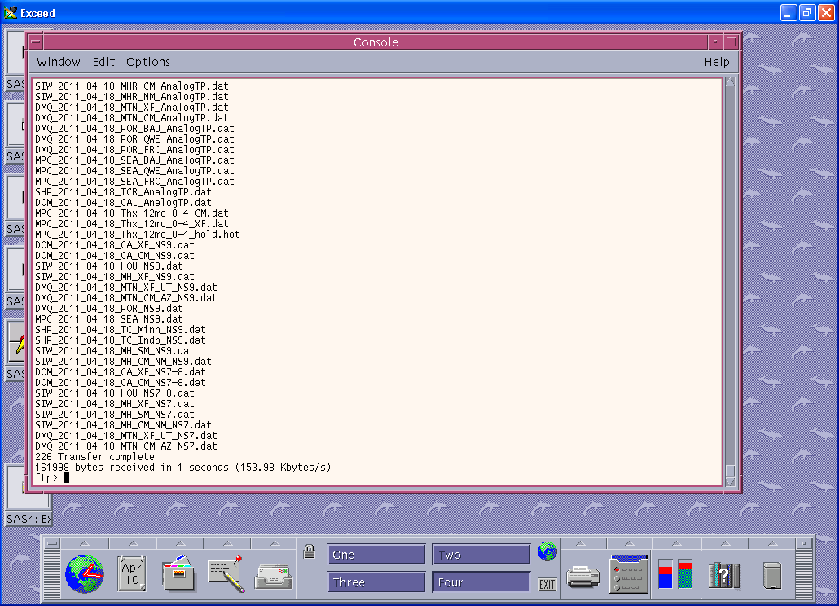

Slide 4
Use FILENAME statement with ftp and ls options to download contents into a SAS Data Set
libname perm '/export/home/mthompso/Counts/Comet/sasds';
filename dir ftp '' ls
Host=‘xxxxx'
User=‘xxxxxxxxxx'
Pass=‘xxxxxxx'
cd='DATA_OUT/DM';

Slide 5
Use data step with infile and input to create SAS data set(s)
data ns_datfiles s_datfiles;
infile dir dsd dlm = ' ';
input cometfile : $80. ;
if substr(cometfile,1,4) = '2011' then do;
month = input(substr(cometfile,6,2),2.);
if month = 02 then save = 1;
end;
if substr(cometfile,5,4) = '2011' then do;
month = input(substr(cometfile,10,2),2.);
if month = 02 then save = 1;
end;
if save then do;
if index(cometfile,'_NS') > 0 then output ns_datfiles;
else output s_datfiles;
end;
drop month save;
run;

Slide 6
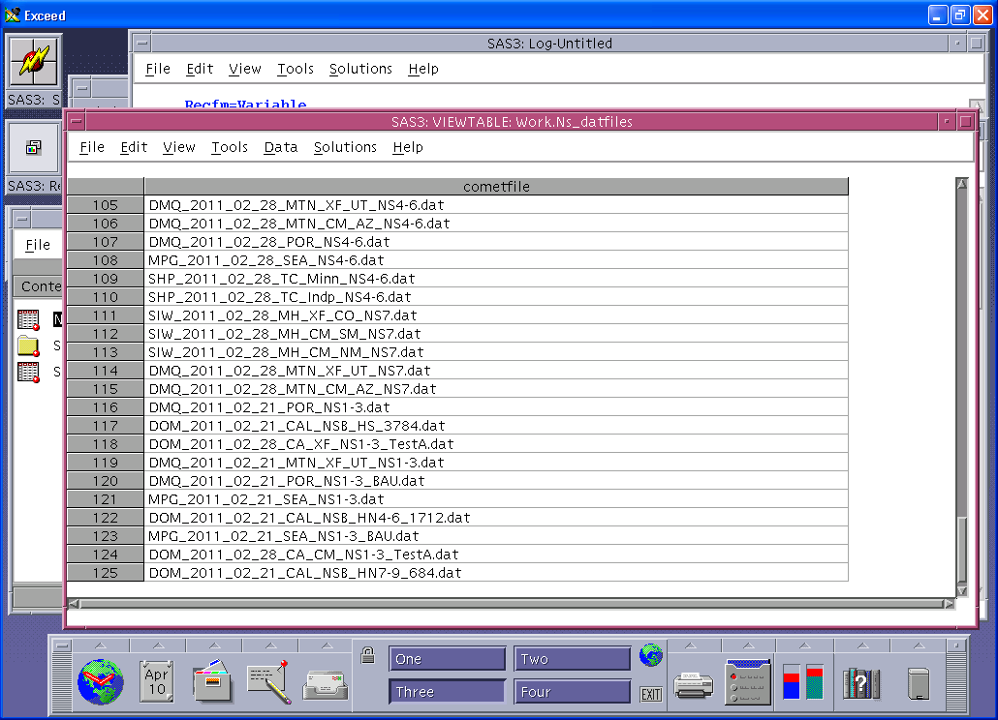

Slide 7
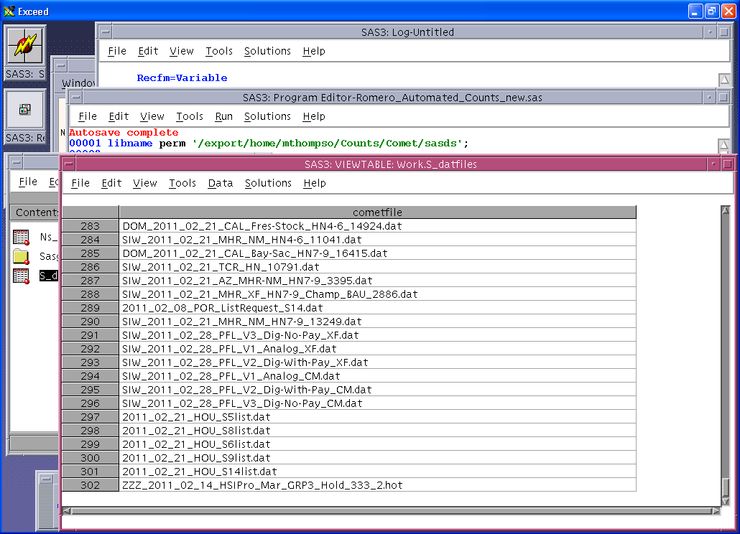

Slide 8
Write SAS program to write SAS Code
data _null_;
file '/export/home/mthompso/COMET/Comet_counts_nonsub.sas';
set ns_datfiles end = last;
fix = trim(left(cometfile))||"'";
put "filename dat ftp '"fix;
put "Host=‘xxxxxx'";
put "User=‘xxxxxxxxxx'";
put "Pass=‘xxxxxxxx'";
put "cd='DATA_OUT/DM';";
put "data file"_n_" ;";
put "infile dat missover dsd dlm='|' firstobs=2;";
put "informat version_id $30.;";
put "input CampaignCode $ RunDate $ CellCode $ version_id $ listdetails $
SALUTATION_FULLNAME $ BILLING_ADDRESS_1 $ BILLING_ADDRESS_2 $
BILLING_CITY $ BILLING_STATE $ BILLING_ZIP $ BILLING_ZIP4 $
BILLING_DPBC $ BILLING_LOT $ BILLING_CRRT $ CORP_SYSPRIN $
BILLING_HOUSE_KEY $ BILLING_ACCT_KEY $ CSG_SPA $ CSG_SPA2 $
DIVISION_NAME $ REGION_NAME $ AUDIENCE_ID $ CMCST_MICRO_SEG $
CMCST_SUPER_SEG $ CSG_NODE $;";
put "run;";

Slide 9
Write proc summary code
put "proc summary data = file"_n_" nway ;";
put "class corp_sysprin version_id;";
put "output out = sum_file"_n_";";
put "run;";

Slide 10
Concatenate Summarized Files
put "data sum_file"_n_";";
put "set sum_file"_n_";";
put "cometfile = '"cometfile "';";
put "run;";
put "data perm.Comet_counts_Nonsubs;";
put "format cometfile $80. version_id $30.;";
if _n_ = 1 then put "set sum_file"_n_";";
else put "set perm.Comet_counts_nonsubs sum_file"_n_";";
if last then put "drop _type_;";
put "run;";
run;

Slide 11
Same process for Subscriber Files
data _null_;
file '/export/home/mthompso/COMET/Comet_counts_sub.sas';
set s_datfiles end = last;
fix = trim(left(cometfile))||"'";
put "filename dat ftp '"fix;
put "Host='nepal'";
put "User='mktwestdiv'";
put "Pass='w3$td1v'";
put "cd='DATA_OUT/DM';";
put "data file"_n_" ;";
put "infile dat missover dsd dlm='|' firstobs=2;";
put "informat version_id $30.;";
put "input CampaignCode $ RunDate $ CellCode $ version_id $ listdetails $
SALUTATION_FULLNAME $ BILLING_ADDRESS_1 $ BILLING_ADDRESS_2 $
BILLING_CITY $ BILLING_STATE $ BILLING_ZIP $ BILLING_ZIP4 $
BILLING_DPBC $ BILLING_LOT $ BILLING_CRRT $ CORP_SYSPRIN $
BILLING_HOUSE_KEY $ BILLING_ACCT_KEY $ CSG_SPA $ CSG_SPA2 $
DIVISION_NAME $ REGION_NAME $ AUDIENCE_ID $ CMCST_MICRO_SEG $
CMCST_SUPER_SEG $ CSG_NODE $;";
put "run;";
put "proc summary data = file"_n_" nway ;";
put "class corp_sysprin version_id;";
put "output out = sum_file"_n_";";
put "run;";
put "data sum_file"_n_";";
put "set sum_file"_n_";";
put "cometfile = '"cometfile "';";
put "run;";
put "data perm.Comet_counts_subs;";
put "format cometfile $80. version_id $30.;";
if _n_ = 1 then put "set sum_file"_n_";";
else put "set perm.Comet_counts_subs sum_file"_n_";";
if last then put "drop _type_;";
put "run;";
run;

Slide 12
Include code to run newly generated code
%include '/export/home/mthompso/COMET/Comet_counts_nonsub.sas';
%include '/export/home/mthompso/COMET/Comet_counts_sub.sas';
First program is 2,876 lines
Second program is 6,947 lines

Slide 13
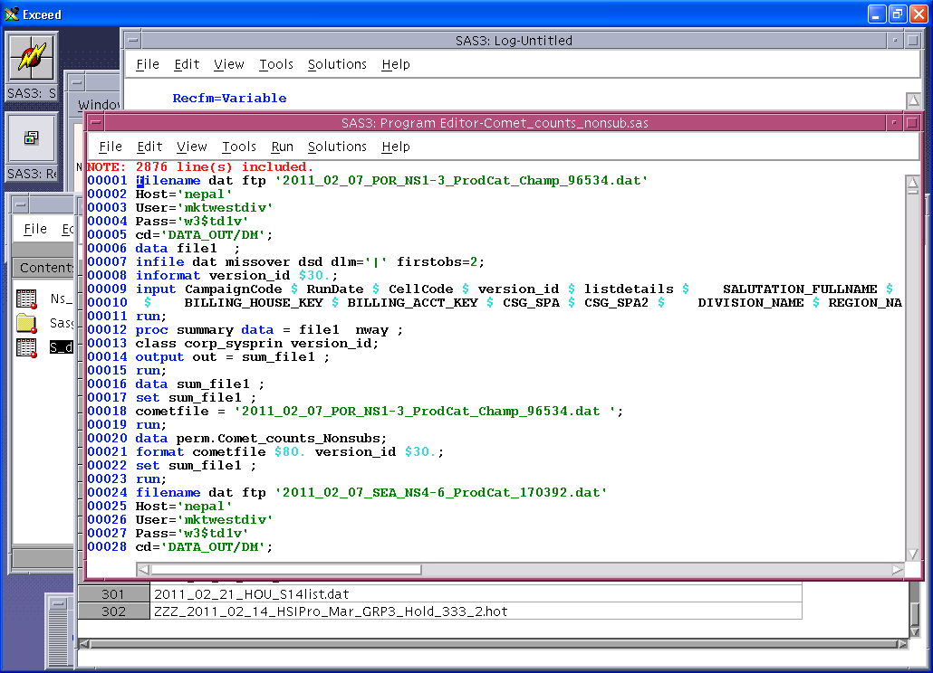

Slide 14
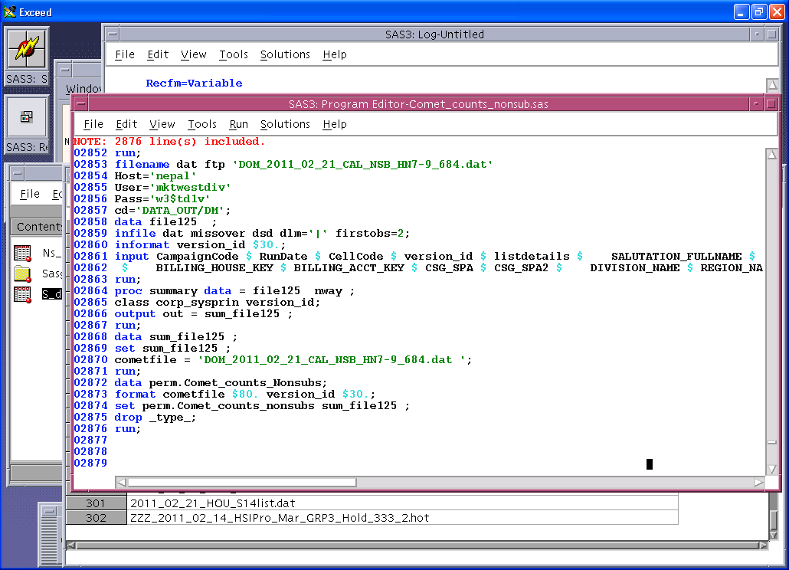

Slide 15
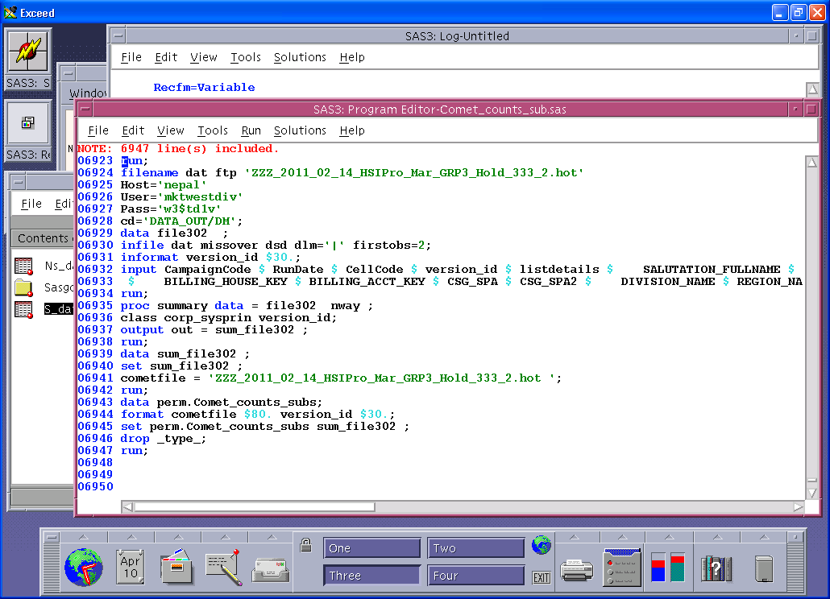

Slide 16
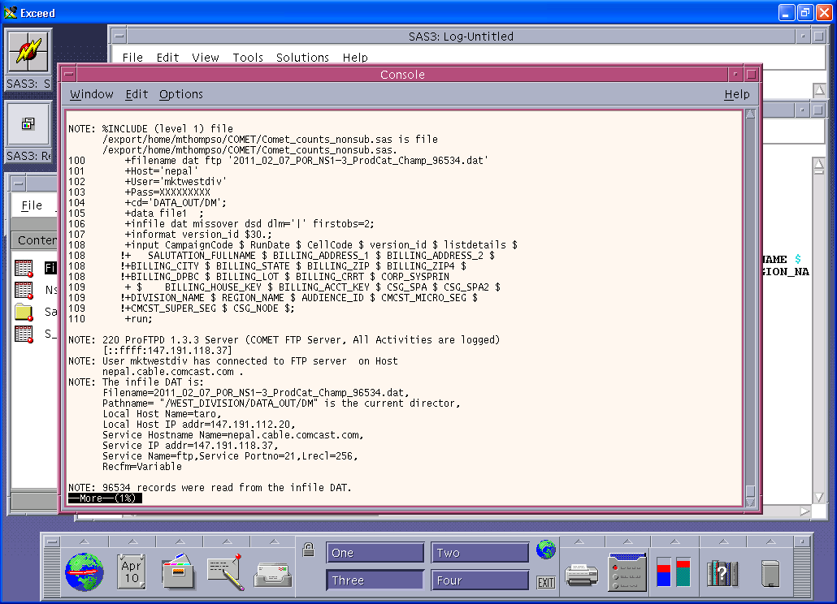

Slide 17
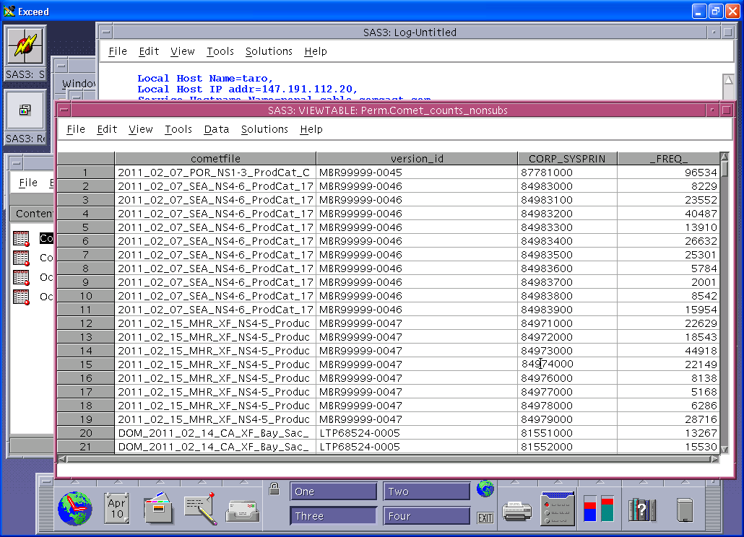

Slide 18
Conclusion
Summarized Data is exported to EXCEL showing exactly how customers have been contacted in each locale
Keys to success:
ls option on filename with ftp
Files have naming convention
Every dat file has same format

